Slide 1

NativeScript 101

Slide 2


NativeScript 101

Slide 3

Rob Lauer
@RobLauer
Senior Manager, Developer Relations

Slide 4

What can we cover today?
Rise of "JavaScript-driven Native"
Intro to NativeScript
NativeScript core concepts
“Hello World”
Extending with plugins
Debugging JavaScript

Slide 5

Why are we here?
How did NativeScript come to be?

Slide 6





Swift/Obj-C
Java
.NET

Slide 7
We ❤ Web.
But…
We need:
Better offline support
Access to all device APIs
Home screen availability
Push notifications
App monetization
App store discovery
…

Slide 8
Hybrid "Promise"
100% Web
Hybrid
100% Native
Compromises.
Reach
Code/Skill Reuse
Best of both?
Richness
Premium experience
Device APIs

Slide 9


Mobile Web - PWA
Hybrid
Native
“1st Gen” X-Plat Native

Slide 10

Binary Choice
Hybrid
Native
🔥 Fast to market
😭 Compromise on UX
😎 Best experience
🐢 One platform at a time

Slide 11


Slide 12
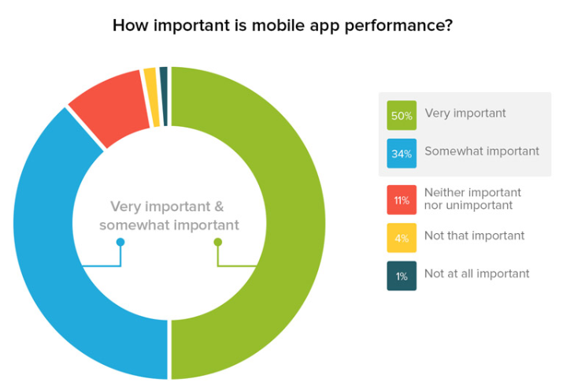
https://info.dynatrace.com/rs/compuware/images/Mobile_App_Survey_Report.pdf

Slide 13
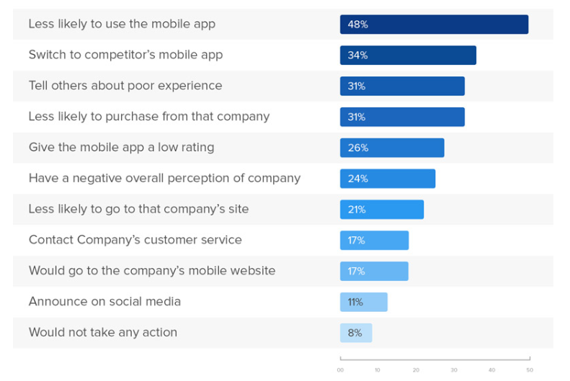
https://info.dynatrace.com/rs/compuware/images/Mobile_App_Survey_Report.pdf

Slide 14
Binary Choice
Hybrid
Native
🔥 Fast to market
😎 Best experience

Slide 15

Native JavaScript
🔥 Fast to market
😎 Best experience

Slide 16
"JavaScript-Driven Native"
Native UI driven by JavaScript
Native App
Native UI
Native APIs
JavaScript-to-Native bridge
JavaScript Engine
(Your app code runs here)

Slide 17





JavaScript-Driven Native
Weex
FuseTools
React Native
(by Facebook)
NativeScript
(by Progress)
Flutter

Slide 18

Native App
Native App
Native UI
Native APIs
Native UI
Native APIs
JavaScript-to-Native runtime
API Wrapper
API Wrapper
API Wrapper
API Wrapper
API Wrapper
API Wrapper
JavaScript Engine
(Your app code runs here)
JavaScript Engine
(Your app code runs here)
Plugins
Plugins
Plugins created with JS/TypeScript
Angular Support (or not ☺)
100% Day 0 API Access
Everything Runs on UI Thread*
Plugins created with native code
React Support
API Access via Native Modules
UI Thread vs JS Thread

Slide 19


Angular/Vue/Vanilla vs React
Progress vs Facebook
Apache 2.0 vs BSD+

Slide 20
JavaScript-Driven Native
🔥 Fast to market
😎 Best experience
Share code
Reuse existing skills/teams
Reuse existing libraries
Native UI (no WebView!)
Full access to device APIs
Immediate access to new OS features

Slide 21
Intro to NativeScript
What is it? How does it work?

Slide 22


Slide 23
Early prototypes
“Core” engineering
Public launch
Adoption ramp-up
Mass adoption
2013
2014
2015
2016
2017
Project Timeline

Slide 24

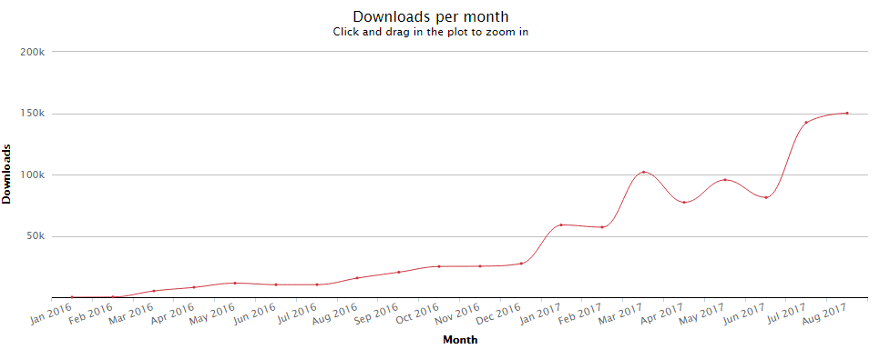
NativeScript npm Downloads

Slide 25
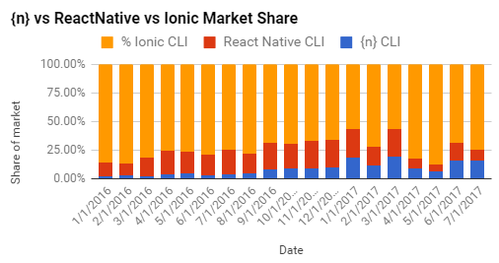

Slide 26
What is NativeScript?
Open source framework (ASLv2)
Create native mobile apps for iOS & Android
Use web skills
JS, CSS, XML-based markup
Write once, run everywhere
Share 100% code between iOS/Android
Share 80% code with web
Reuse popular plugins from NodeJS/iOS/Android
Integrates deeply with Angular and TypeScript

Slide 27

The {N} difference…

Slide 28

1
Rich, animated, “no compromise” native UI
(with shared UI code)
Demo available in the app stores

Slide 29
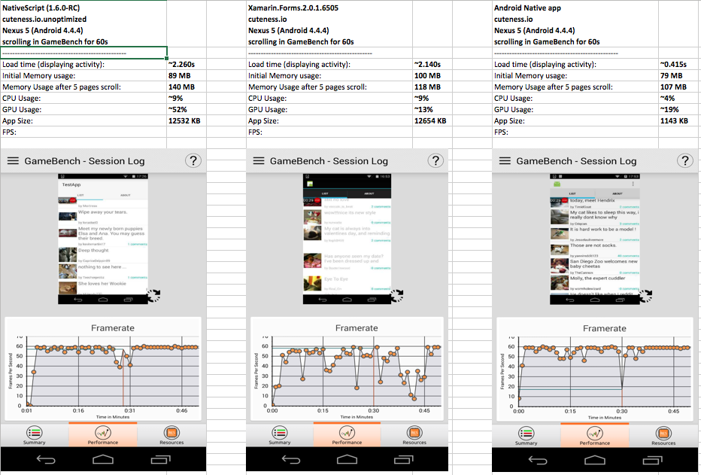



2
Measurable native UI performance
(“no jank”)

Slide 30

NativeScript 3.x ==

Slide 31
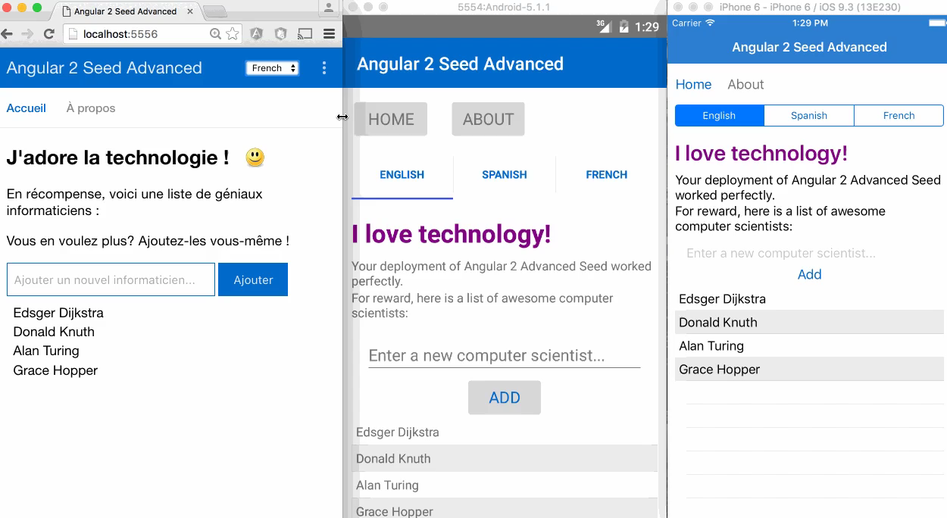
3
Maximum code and skill reusability
Video credit: Nathan Walker, {N} community member

Slide 32




4
Reuse existing native libraries

Slide 33

How does NativeScript work?
Under the covers

Slide 34


Slide 35
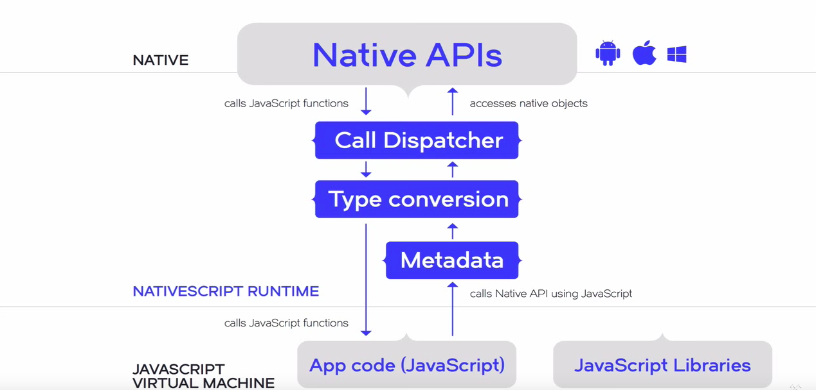
Generated at build time for OS & 3rd party native libraries

Slide 36
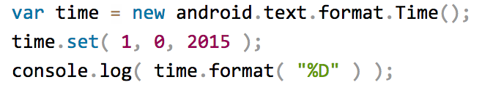
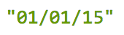
NativeScript Android Example
output:
JavaScript

Slide 37
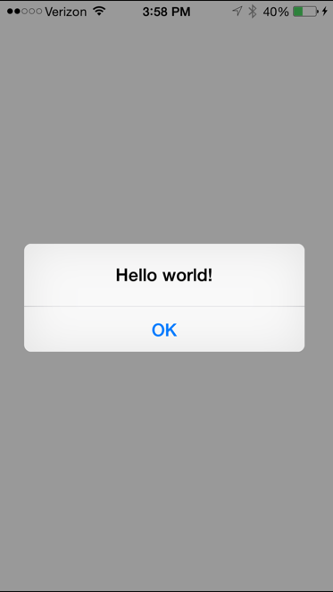
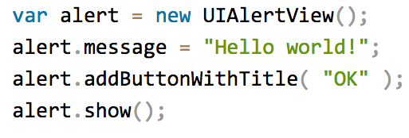
NativeScript iOS Example
JavaScript

Slide 38
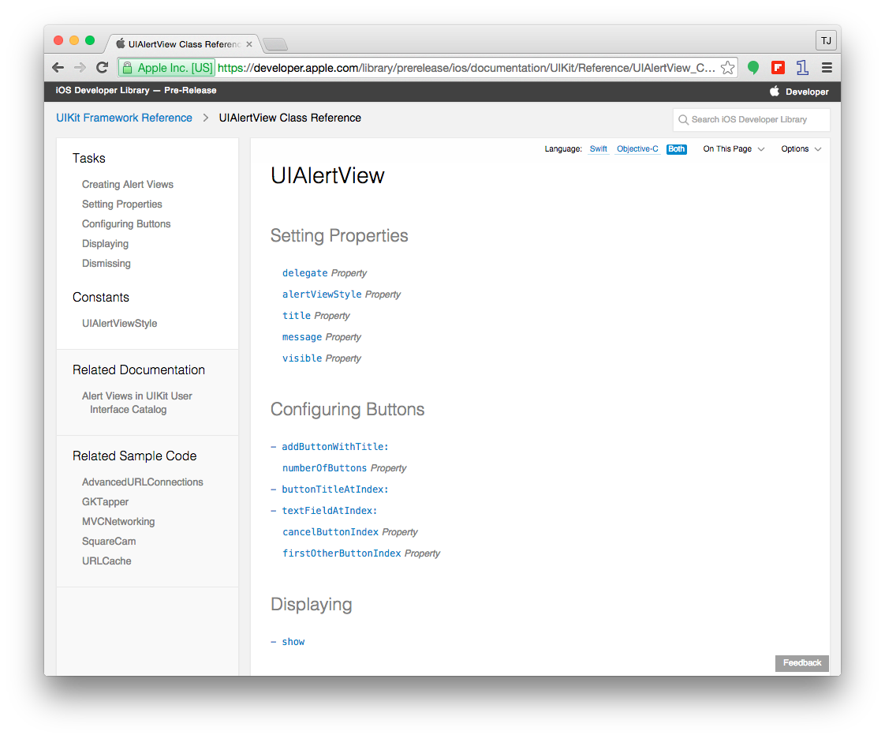

Slide 39
Runs on V8 JavaScript VM
Runs on JavaScriptCore VM

Slide 40
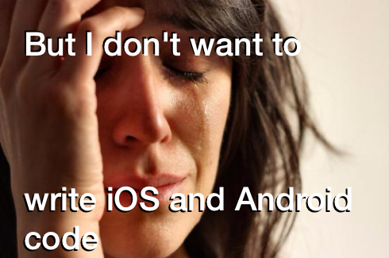

Slide 41
NativeScript Module Layer (NML)
Abstractions on native APIs provide unified, cross-platform API
Dozens available out of the box
Easy for developers to add
All native APIs still available at JavaScript layer for platform-specific scenarios
NativeScript modules follow Node module conventions (CommonJS)

Slide 42
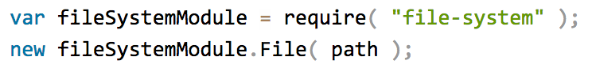

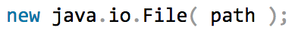

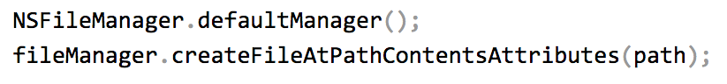
Example: NativeScript file module

Slide 44

BUT HOW DO I TURN THIS INTO AN APP?

Slide 45

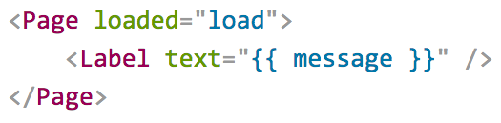
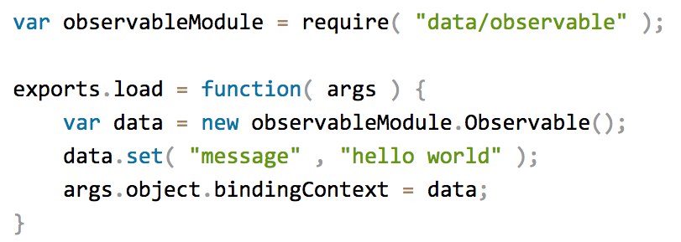
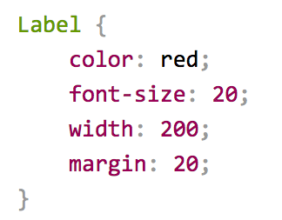
Putting it all together
Define UI with Markup
Logic with JavaScript
Style with CSS

Slide 46




Choice in Architecture
JavaScript
Write your application using plain JavaScript
TypeScript
Use TypeScript to get Object Oriented features and compile time error checking
Angular
Use Angular to architect application. Reuse almost all code between web and mobile

Slide 47

“Hello World”
Let's roll-up our sleeves

Slide 48

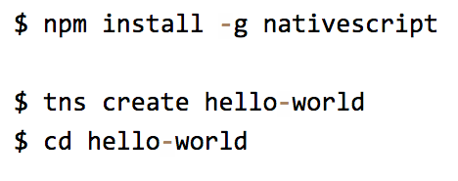
Starting a New Project

Slide 49
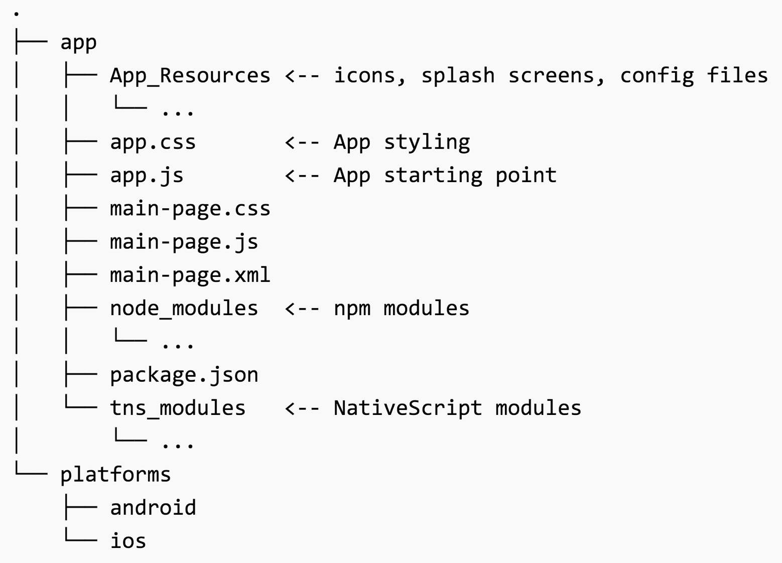

Slide 50

Running on iOS
$ tns run ios

Slide 51
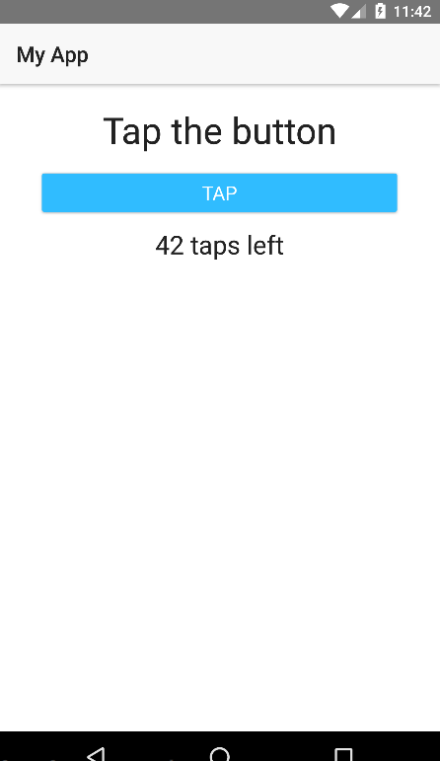
Running on Android
$ tns run android

Slide 52
Alternative Android Emulators
Genymotion
Visual Studio Android Emulator

Slide 53
NativeScript LiveSync
$ tns run //For all connected devices/emulators
$ tns run android //Target specific platform
$ tns run ios --emulator
Refresh app with latest changes to JS, CSS, XML
No re-build
Works with emulators AND devices

Slide 54

DEMO

Slide 55


NativeScript Core Concepts
Let’s look at the and

Slide 56
Defining Views

Slide 57
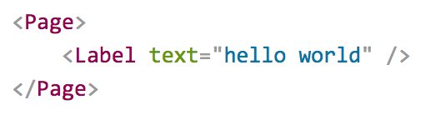
Pages/Views
XML markup structure
Elements (e.g. <Page>, <Label>) are NativeScript modules

Slide 58

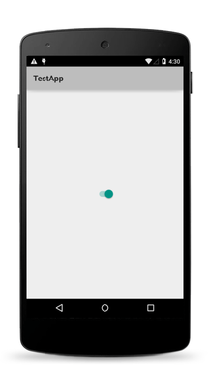
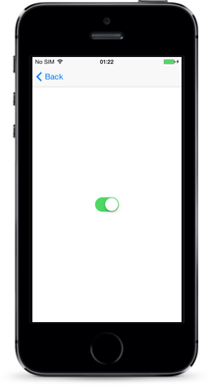
NativeScript Modules for UIs

Slide 59
UI Widgets
Out-of-the-box
Button
Label
TextField
TextView
SearchBar
Switch
Slider
Progress
ActivityIndicator
Image
ListView
HtmlView
WebView
TabView
SegmentedBar
DatePicker
TimePicker
ListPicker
Dialogs
Native UI widgets means…
Native behavior
Native perf
Native accessibility
Parity with “native”

Slide 60
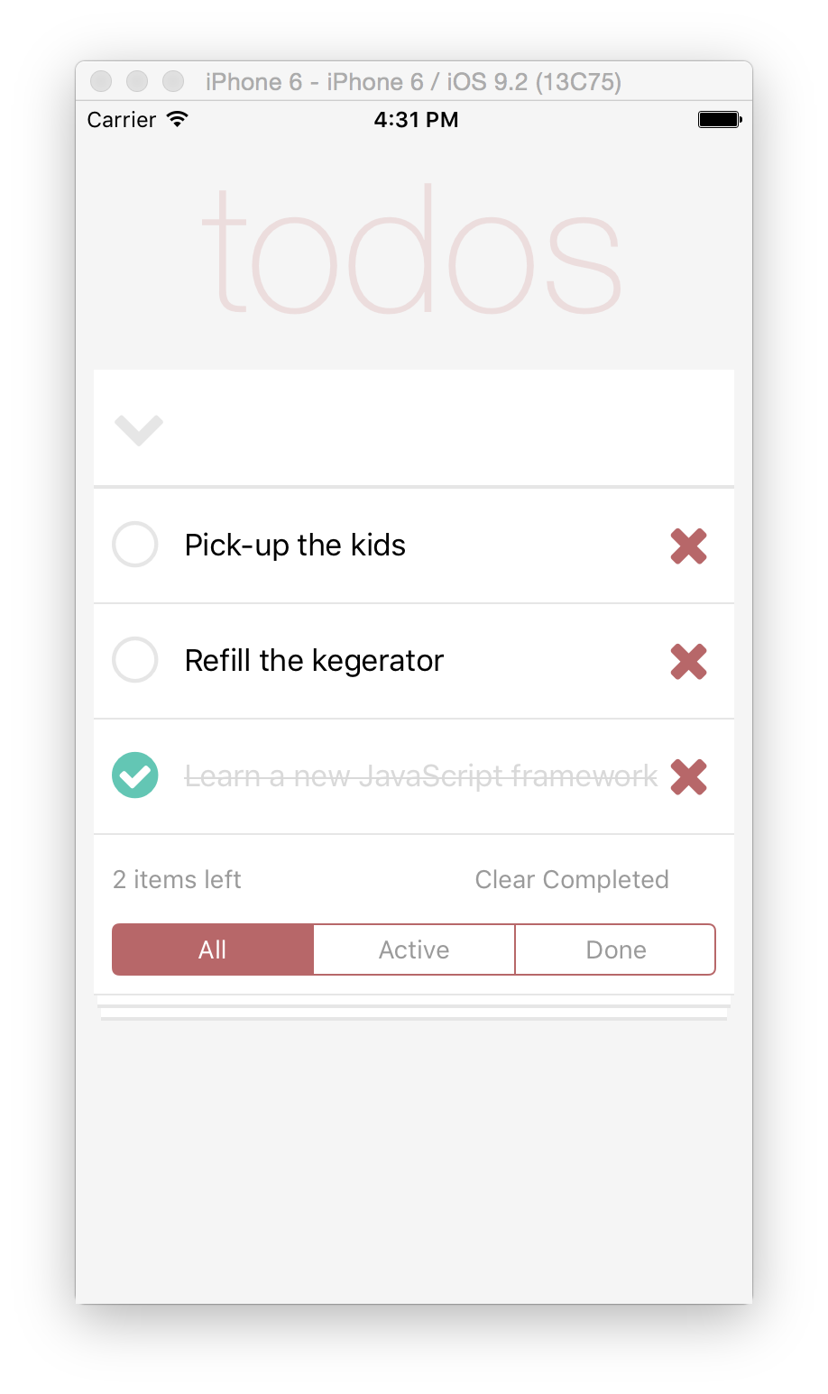


Slide 61
Label
TextField
Repeater
SegmentedBar

Slide 62
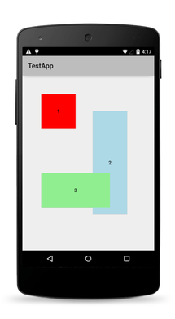
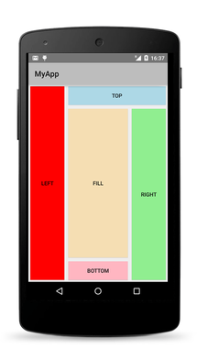
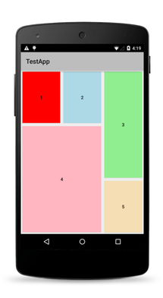
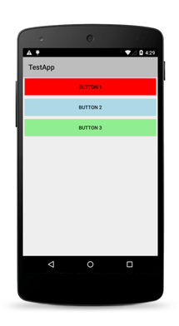
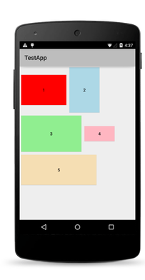
Layouts (Traditional)
Absolute
Dock
Grid
Stack
Wrap

Slide 63
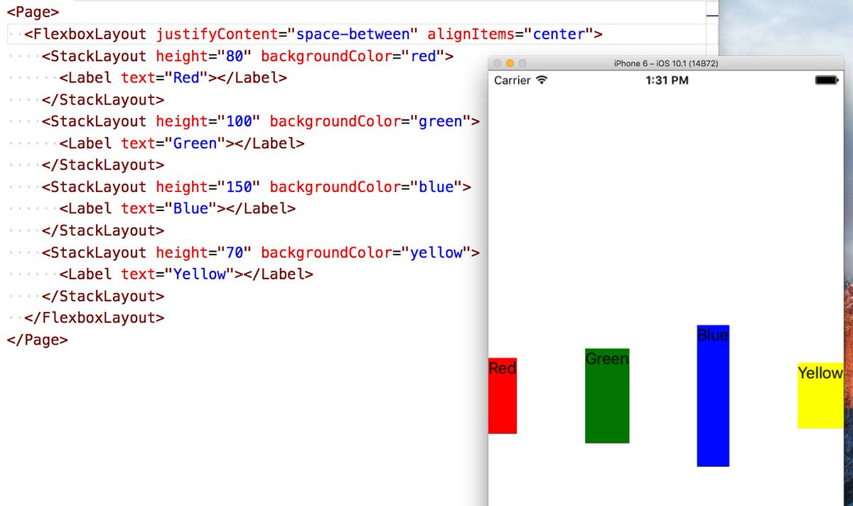
Layouts (Flexbox)

Slide 64
StackLayout
GridLayout
Label
TextField
GridLayout

Slide 65
Platform-Specific Capabilities
Files: <view>.android or <view>.ios
Markup: <android></android> or <ios></ios>
Attributes: android:<attribute> or ios:<attribute>
Ex: <label android:class="…" ios:class="…" />
Write once by default.
Target specific platform capabilities when needed.

Slide 66

Styling with CSS

Slide 67
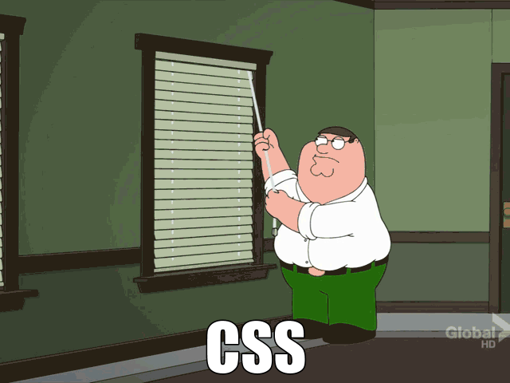

Slide 68
CSS
Convention:
app.css <-- Global styles
[viewName].css <-- View styles
[viewName].[platform].css

Slide 69
Supported Properties
color
background-color
background-image
background-repeat
background-position
background-size
border-color
border-width
border-radius
font
font-family
font-size
font-style
font-weight
text-align
text-decoration
text-transform
vertical-align
horizontal-align
margin
margin-top
margin-right
margin-bottom
margin-left
width
height
min-width
min-height
padding
padding-top
padding-right
padding-bottom
padding-left
visibility
opacity

Slide 70
Supported Selectors
Element Type
button { color: red; }
Class
.mybutton { color: green; }
ID
#myButton { color: #f7f7f7; }

Slide 71
Sass & LESS
Use Sass or LESS syntax
Auto-compiled
$ tns install sass
OR
$ tns install less

Slide 72
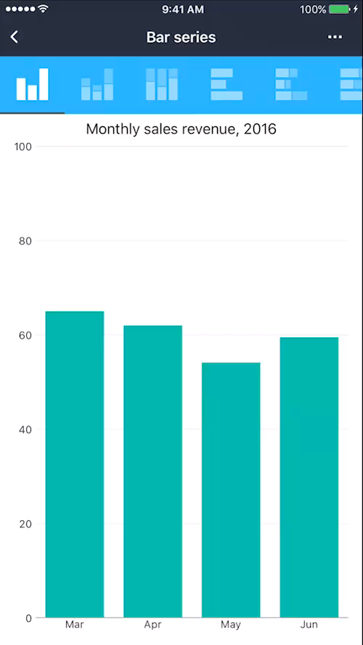
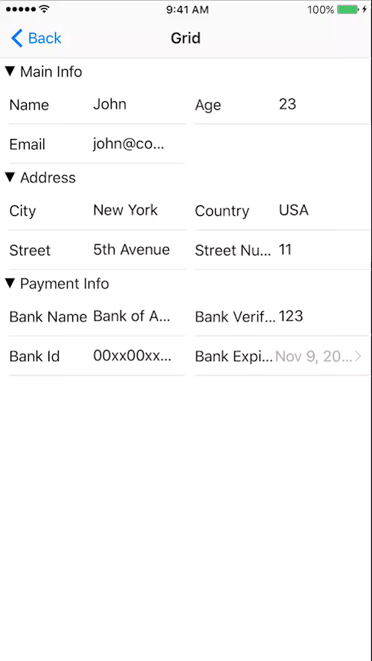
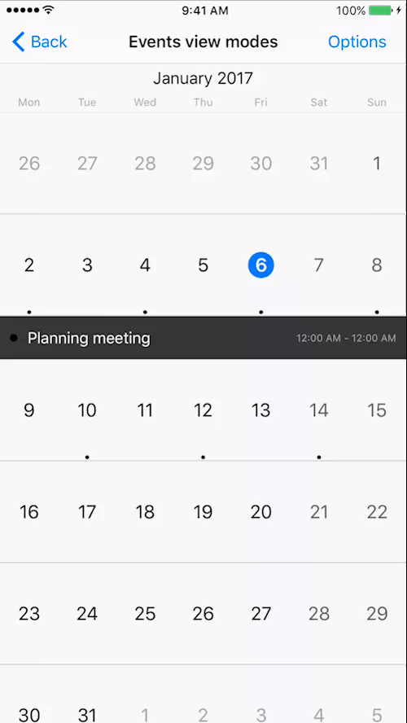
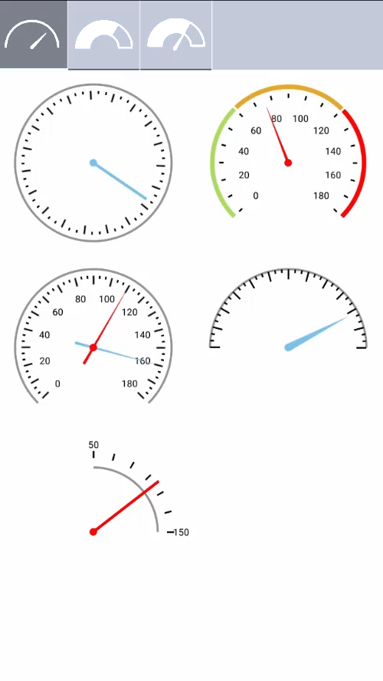
Progress NativeScript UI
nativescript.org/ui-for-nativescript

Slide 73

JavaScript All The Things

Slide 74
JavaScript Code Behind
Vanilla JavaScript
Built-in MVVM Pattern
Angular Support
TypeScript Support
Vue Support (Community-Driven)
Preact Support (Community-Driven)

Slide 75

Debugging Strategies
Debug by alert (no really)
Debug by console.log
Debug by Developer Tools
Chrome DevTools
Safari Web Inspector
Debug by IDE
Visual Studio
Visual Studio Code

Slide 76



DevTools Support
 | Android Chrome DevTools | iOS Safari AppInspector | iOS Chrome DevTools | VSCode Extension
Debugger
Console
Resources
Network
Elements
Memory Profiling
Timeline/CPU Prof.

Slide 77
Anything Else?

Slide 78
Two easy ways to use NativeScript
1)
NativeScript CLI
2)
NativeScript Sidekick

Slide 79
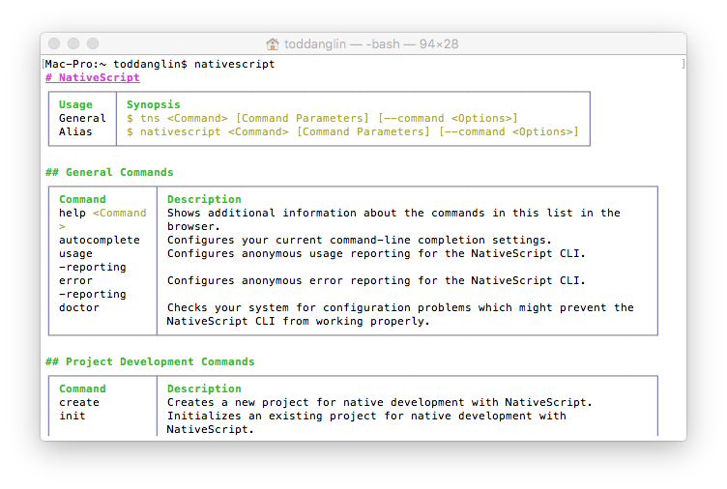
Command Line Interface (CLI)
Use Command Prompt (Win) or Terminal (Mac, Linux)
Free, Part of open source project
Requires installation, local environment setup to build for iOS/Android (requires Mac for iOS)
Integrates with Visual Studio Code (via plugin)
WHY: More control, Free, Integrate with existing IDEs/code editors
WHO: More technical developers used to using CLI, Open source developers

Slide 80
NativeScript CLI
$ npm install –g nativescript
JDK, Apache Ant, Android SDK
Xcode, Xcode CLI tools, iOS SDK
docs.nativescript.org

Slide 81
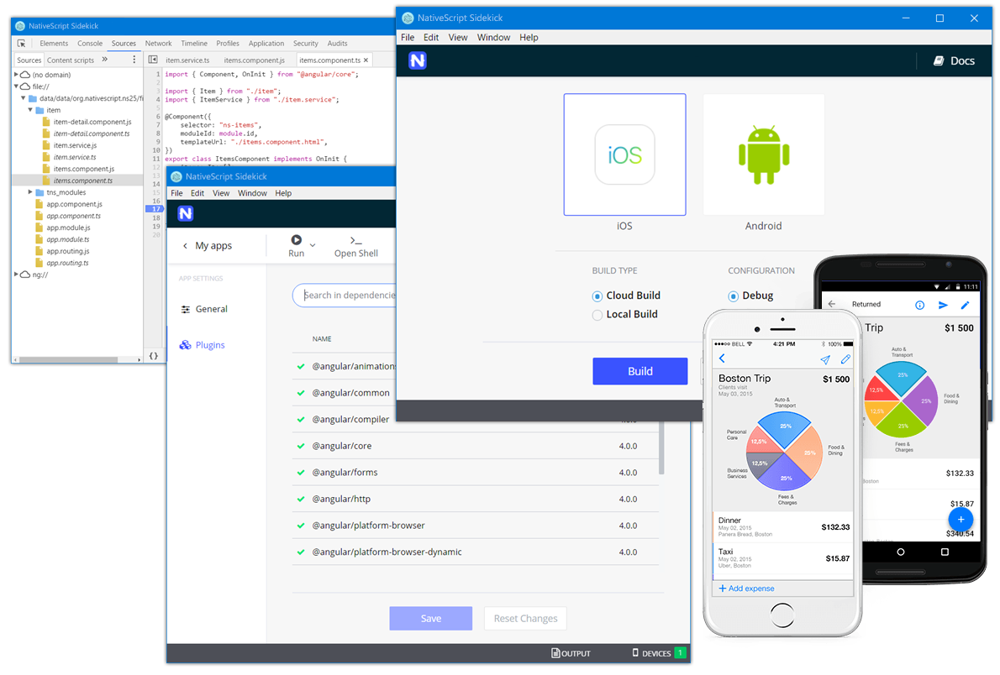
NativeScript Sidekick
Tool for Mac/Windows/Linux
Cloud Builds
LiveSync, Debugging, Starter Kits
Plugins Management
Visual Studio Integration Coming
Public Beta Now!
WHY: Easier bootstrapping, no SDK management, Easy debugging
WHO: Windows developers, Visual tooling

Slide 82

{N} Community

Slide 83
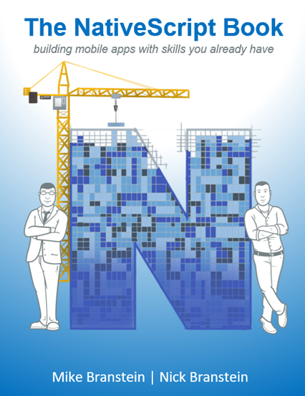
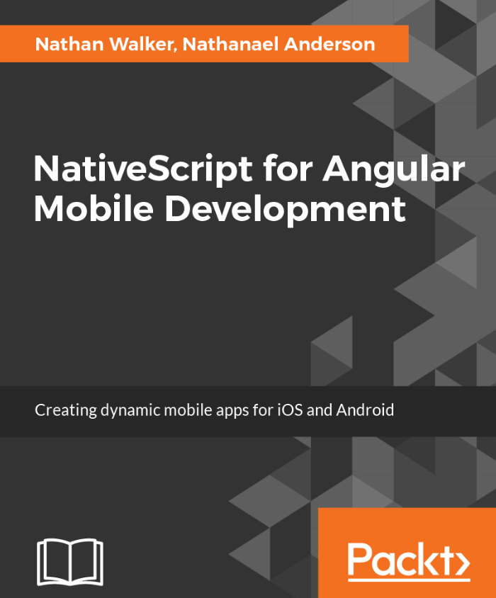
New NativeScript Books!

Slide 84
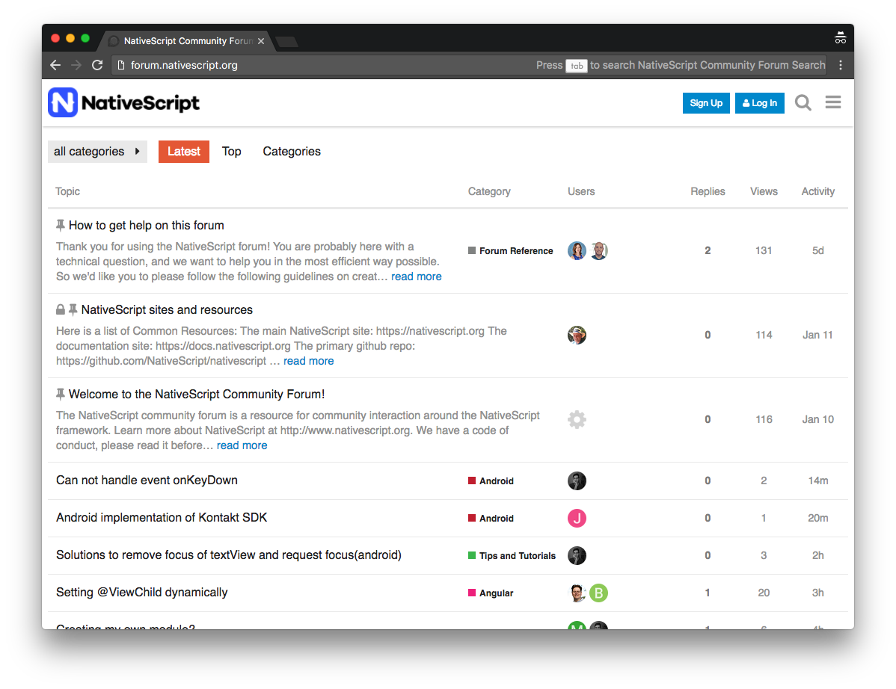
NativeScript Community Forum (forum.nativescript.org)

Slide 85
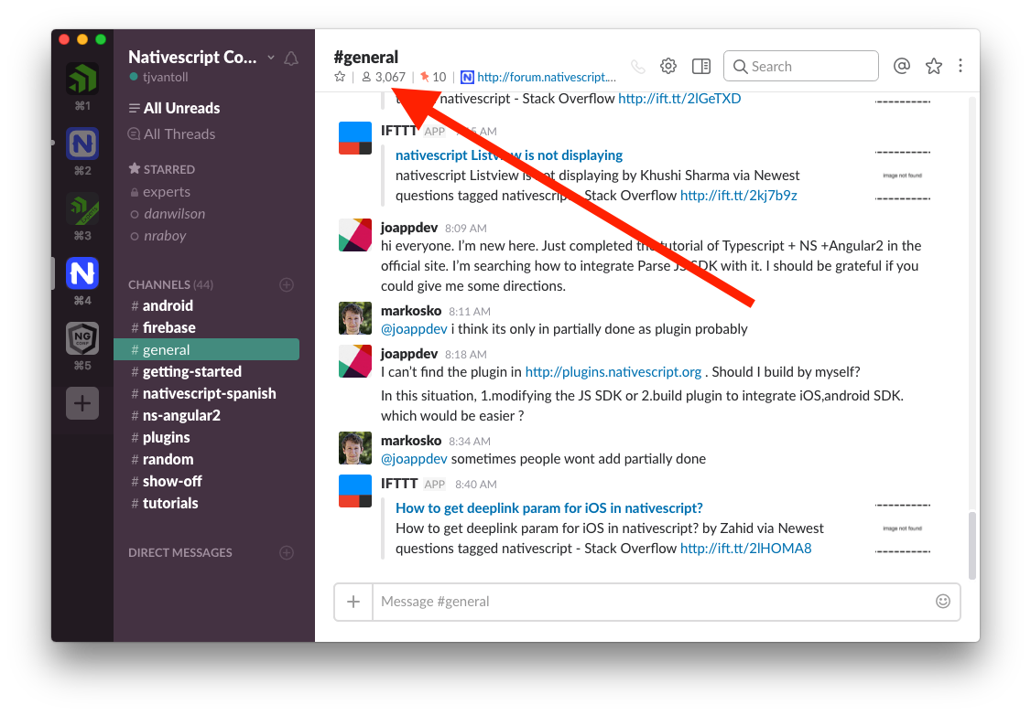
NativeScript Community Slack

Slide 86


Slide 87
Bottom Line
No web views (platform native UI)
Use JavaScript (or TypeScript)
100% access to ALL native APIs (even new APIs)
Made for “web developers” (JS, CSS, XML)
Use Angular for web AND native mobile
Reuse thousands of existing libraries

Slide 88
NativeScript is…
an open source framework for building truly native mobile apps with JavaScript. Use web skills, like Angular and CSS, and get native UI and performance on iOS and Android.

Slide 89
NativeScript.org

Slide 90




Thank You! Next Up: {N} Tooling!
@RobLauer
nativescript.org/blog
rob.lauer@progress.com

